Slide 1
Novel AI Input Support Tool for android.
新たな入力支援ツールが登場！
[Novel AI Input Support Tool]
Novel AI Input Support Tool

Slide 2
Abstract
What is this?
Function introduction
Enjoy!

Slide 3

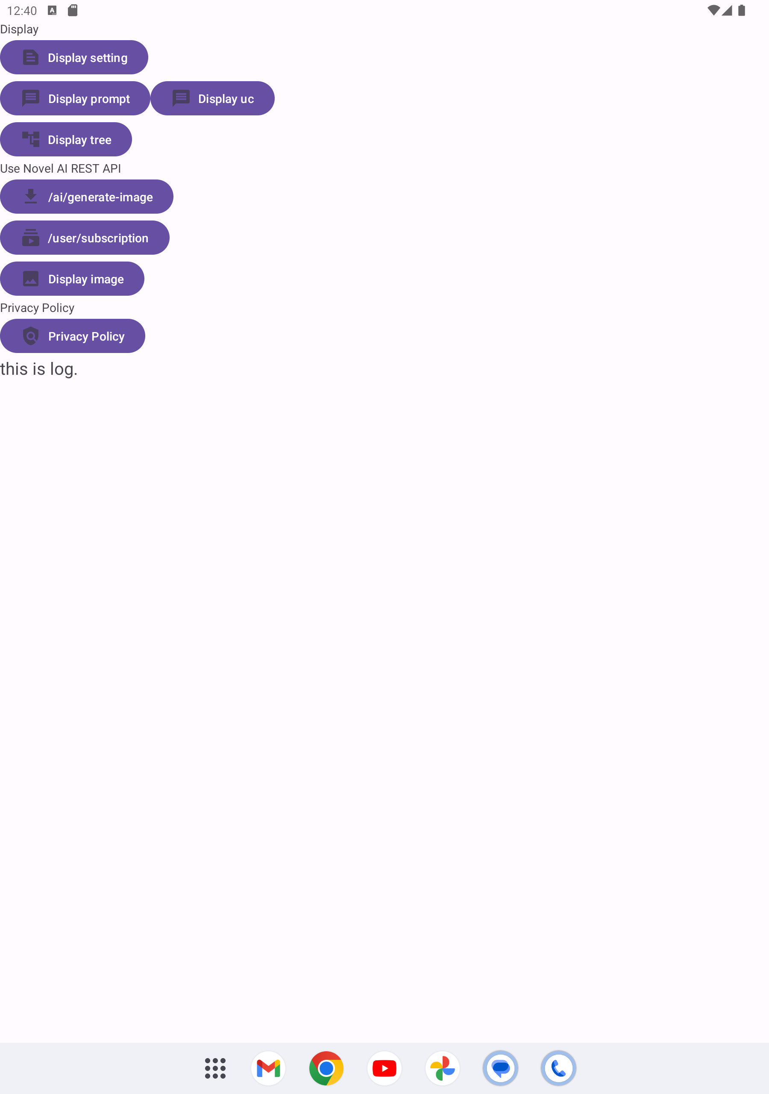
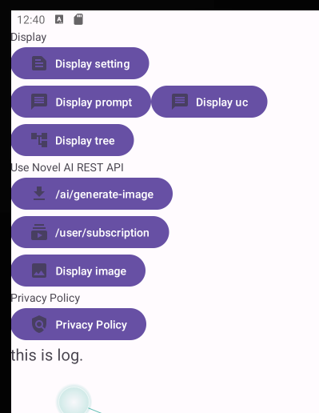
What is this?

Slide 4
Function introduction

Slide 5
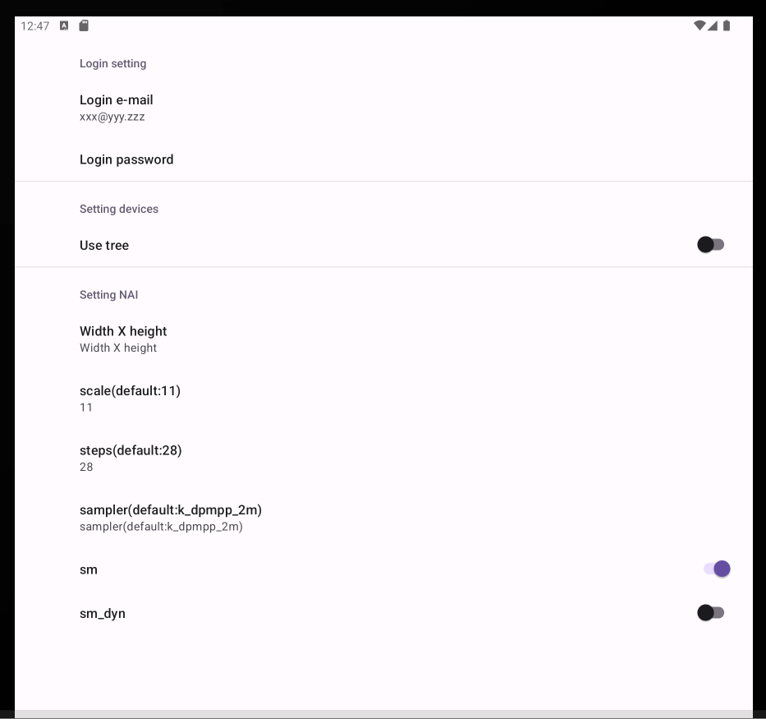
Function introduction

Slide 6
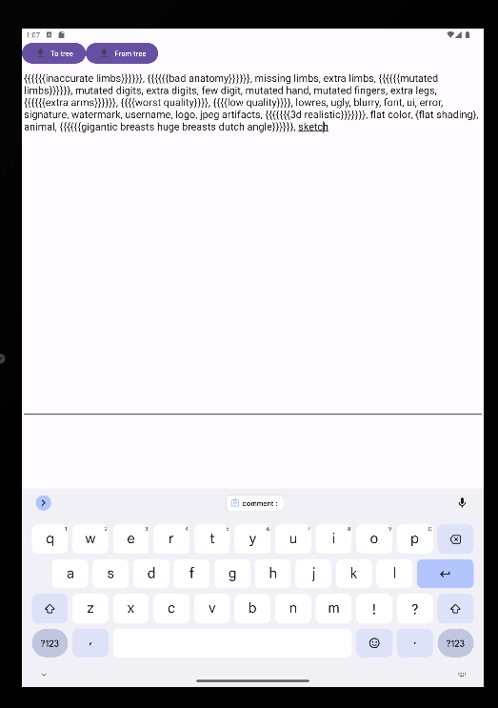
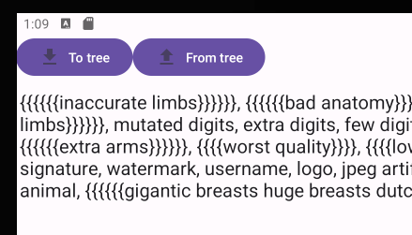
Function introduction /Prompt or Uc
Send to tree
Send from tree

Slide 7
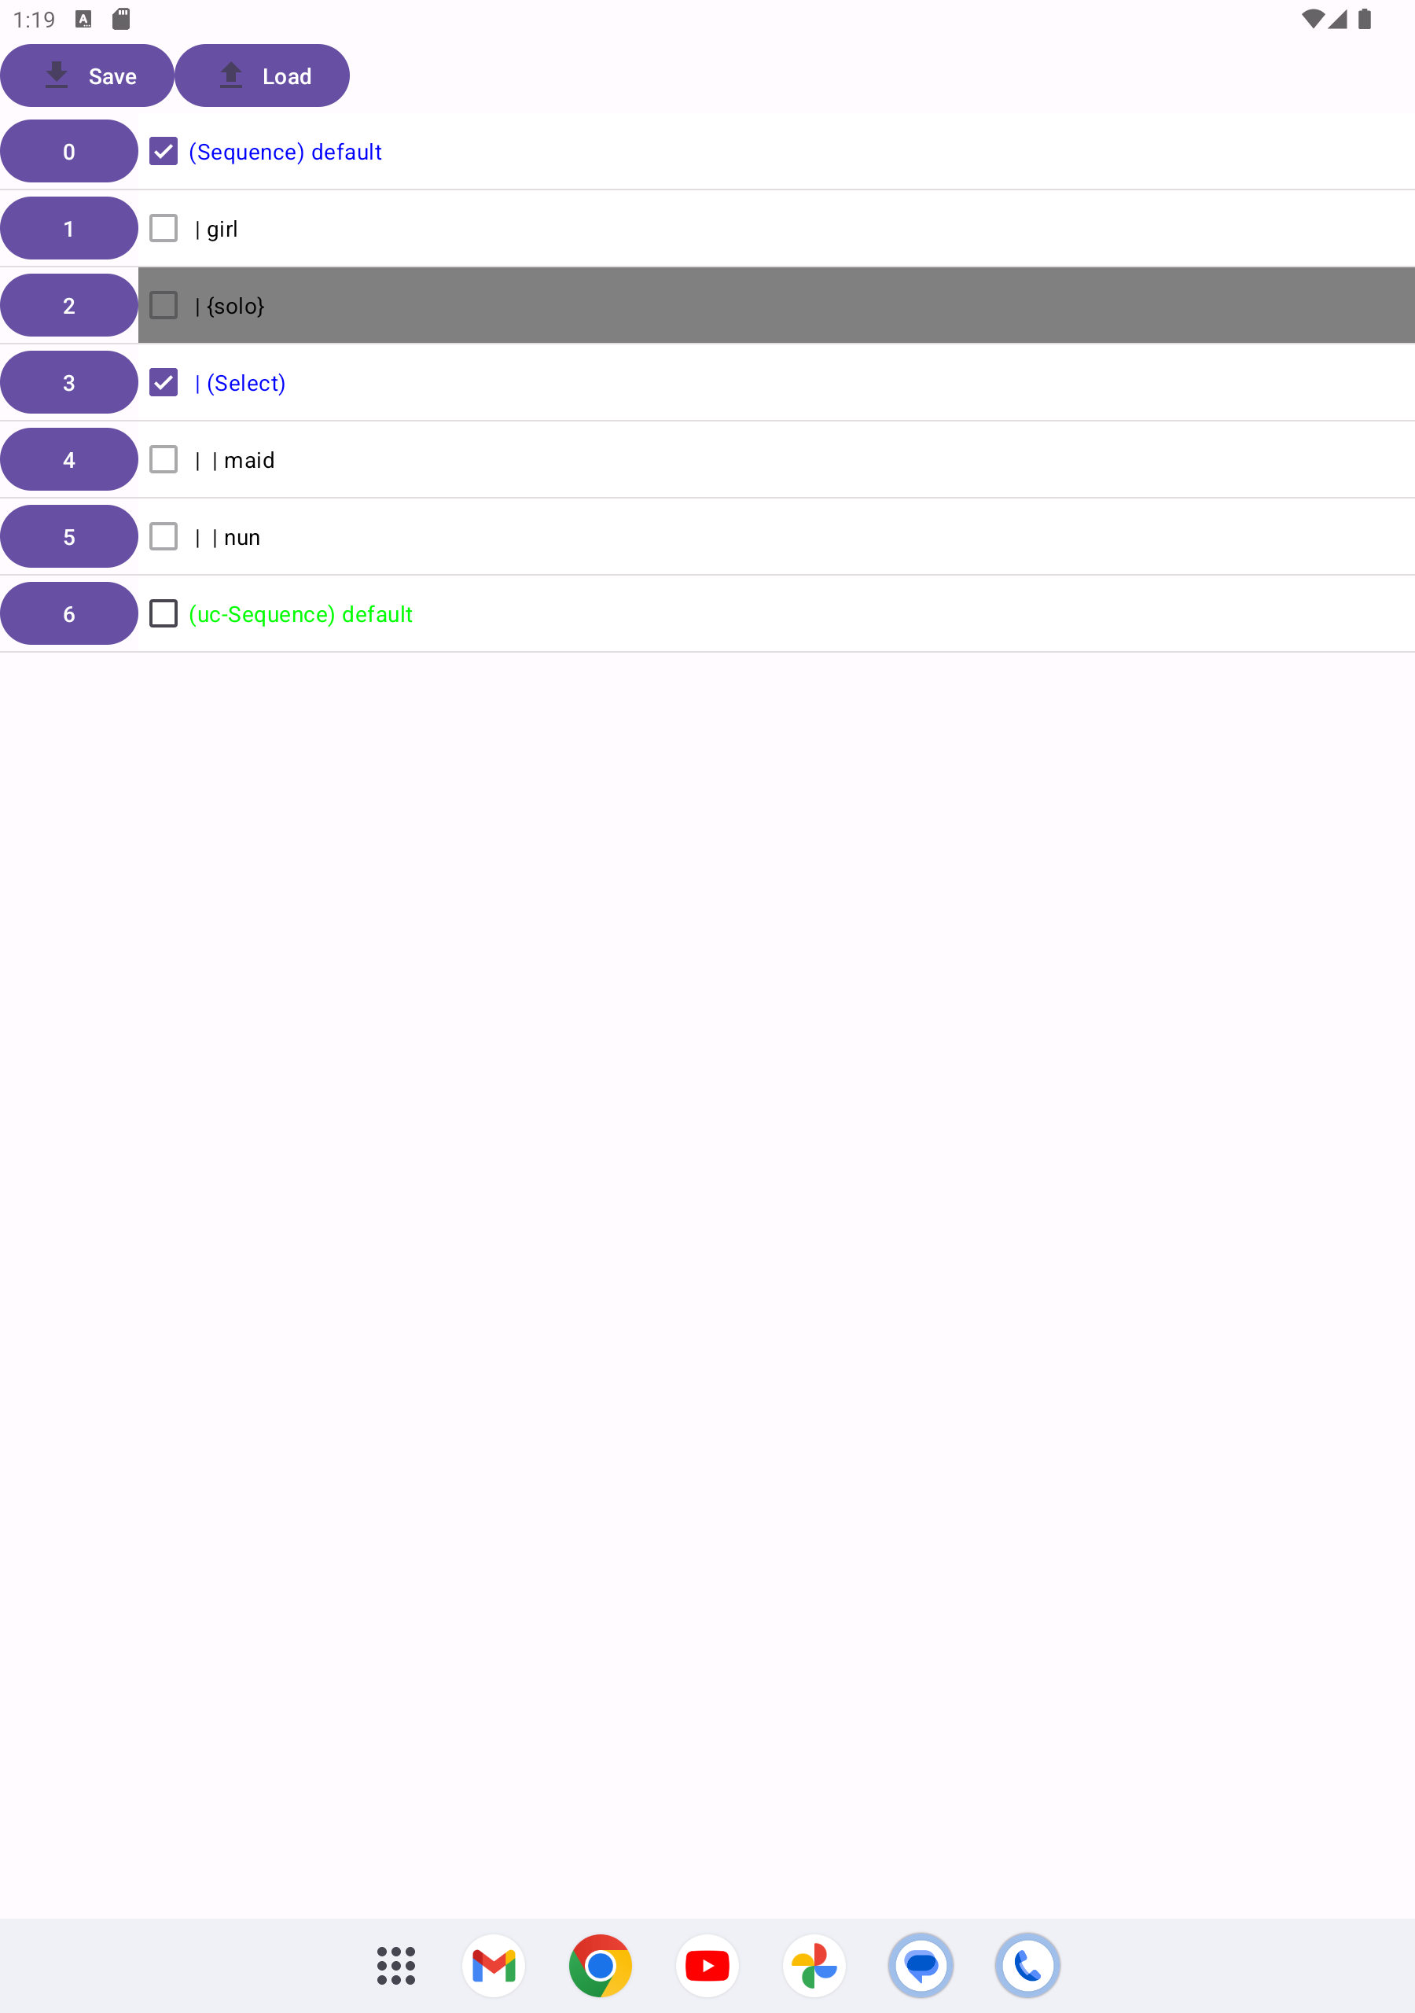
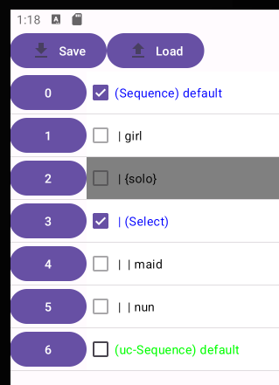
Function introduction/Tree
Send from tree
Send to tree

Slide 8
Function introduction/Tree
Ignore data
Expand tree
Uc data

Slide 9
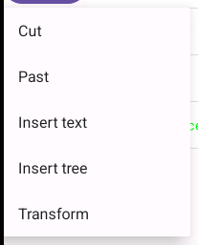
Function introduction/Tree
item button
sub menu

Slide 10
Function introduction/Tree
item button
sub menu

Slide 11
Function introduction/Tree
Cut tree
Past tree

Slide 12
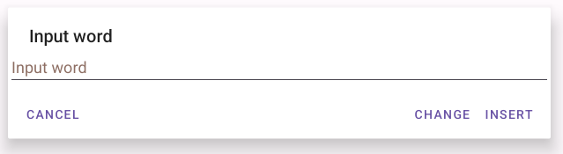
Function introduction/Tree
Change
Insert

Slide 13
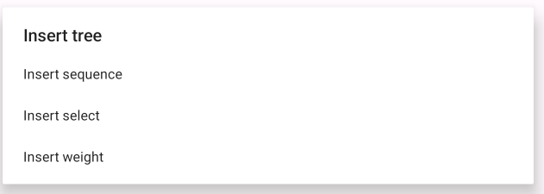
Function introduction/Tree

Slide 14
Function introduction/Tree / Insert tree
Sequence
Select
Weight
- Sequence
- aaa
- bbb
- ccc
- Sequence
- aaa
- bbb
- ccc
- Weight
- aaa
- bbb
- ccc
Send only one with equal probability
Send only one with first probability
Send all
Text Tab
Text Tab
Text Tab
aaa, bbb, ccc
bbb
aaa

Slide 15
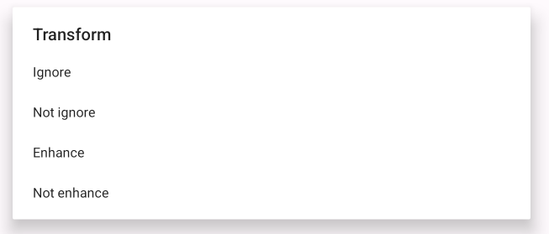
Function introduction/Tree / Transform

Slide 16
Function introduction/Tree / Transform
{{{NSFW}}}
NSFW
[[[NSFW]]]
Enhance
Not Enhance

Slide 17
Function introduction/ Image

Slide 18
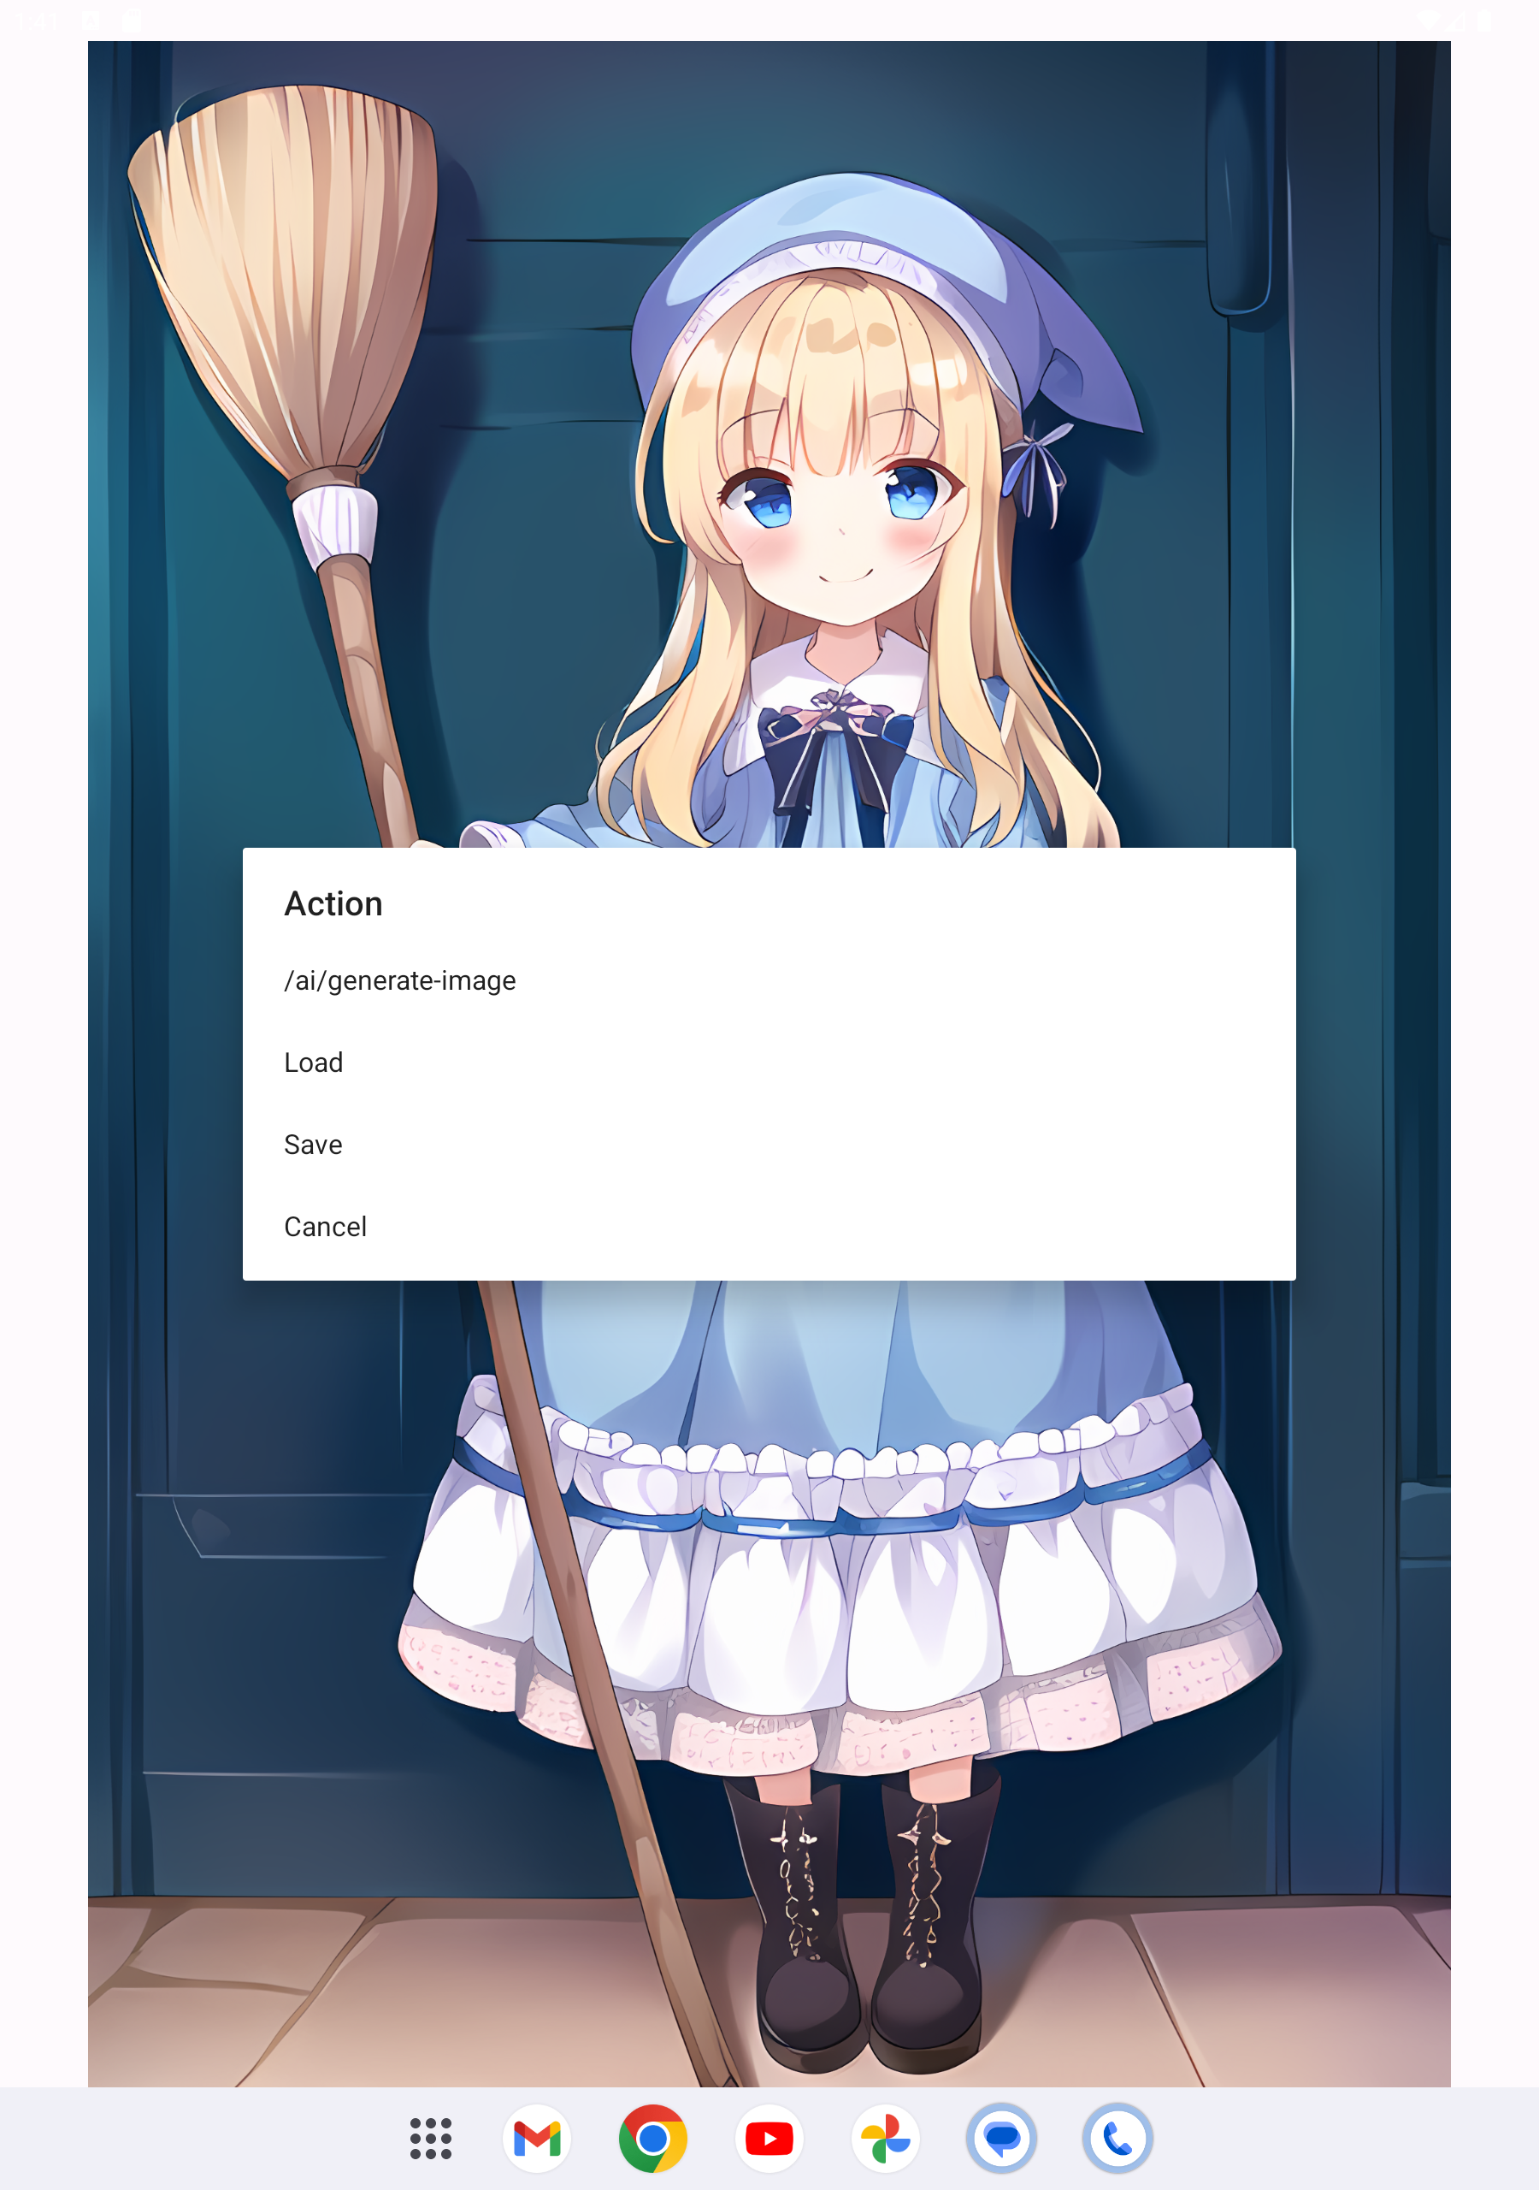
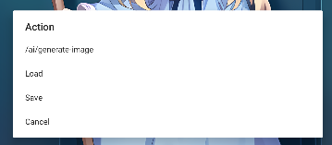
Function introduction/ Image
Generate
Load
Save

Slide 19
Enjoy!
・To be continued.
ポイント
そのとき、ふとひらめいた！
この経験は〇〇な画像の作成に活かせるかもしれない。

